Slide 1
Lending Club Case Study
Group Members :
Indrashis Chatterjee
Ranjan Choudhury

Slide 2
Problem Statement
The company is the largest online loan marketplace, facilitating personal loans, business loans, and financing of medical procedures. Like most other lending companies, lending loans to ‘risky’ applicants is the largest source of financial loss (called credit loss).
The aim is to identify patterns which indicate if a person is likely to default, which may be used for taking actions such as denying the loan, reducing the amount of loan, lending (to risky applicants) at a higher interest rate, etc.
In other words, the company wants to understand the driving factors (or driver variables) behind loan default, i.e. the variables which are strong indicators of default. The company can utilise this knowledge for its portfolio and risk assessment.

Slide 3
Business Understanding
You work for a consumer finance company which specializes in lending various types of loans to urban customers. When the company receives a loan application, the company has to make a decision for loan approval based on the applicant’s profile. Two types of risks are associated with the bank’s decision:
If the applicant is likely to repay the loan, then not approving the loan results in a loss of business to the company
If the applicant is not likely to repay the loan, i.e. he/she is likely to default, then approving the loan may lead to a financial loss for the company

Slide 4
Business Understanding
When a person applies for a loan, there are two types of decisions that could be taken by the company:
Loan accepted: If the company approves the loan, there are 3 possible scenarios described below:
Fully paid: Applicant has fully paid the loan (the principal and the interest rate)
Current: Applicant is in the process of paying the instalments, i.e. the tenure of the loan is not yet completed. These candidates are not labelled as 'defaulted'.
Charged-off: Applicant has not paid the instalments in due time for a long period of time, i.e. he/she has defaulted on the loan
Loan rejected: The company had rejected the loan (because the candidate does not meet their requirements etc.). Since the loan was rejected, there is no transactional history of those applicants with the company and so this data is not available with the company (and thus in this dataset)

Slide 5
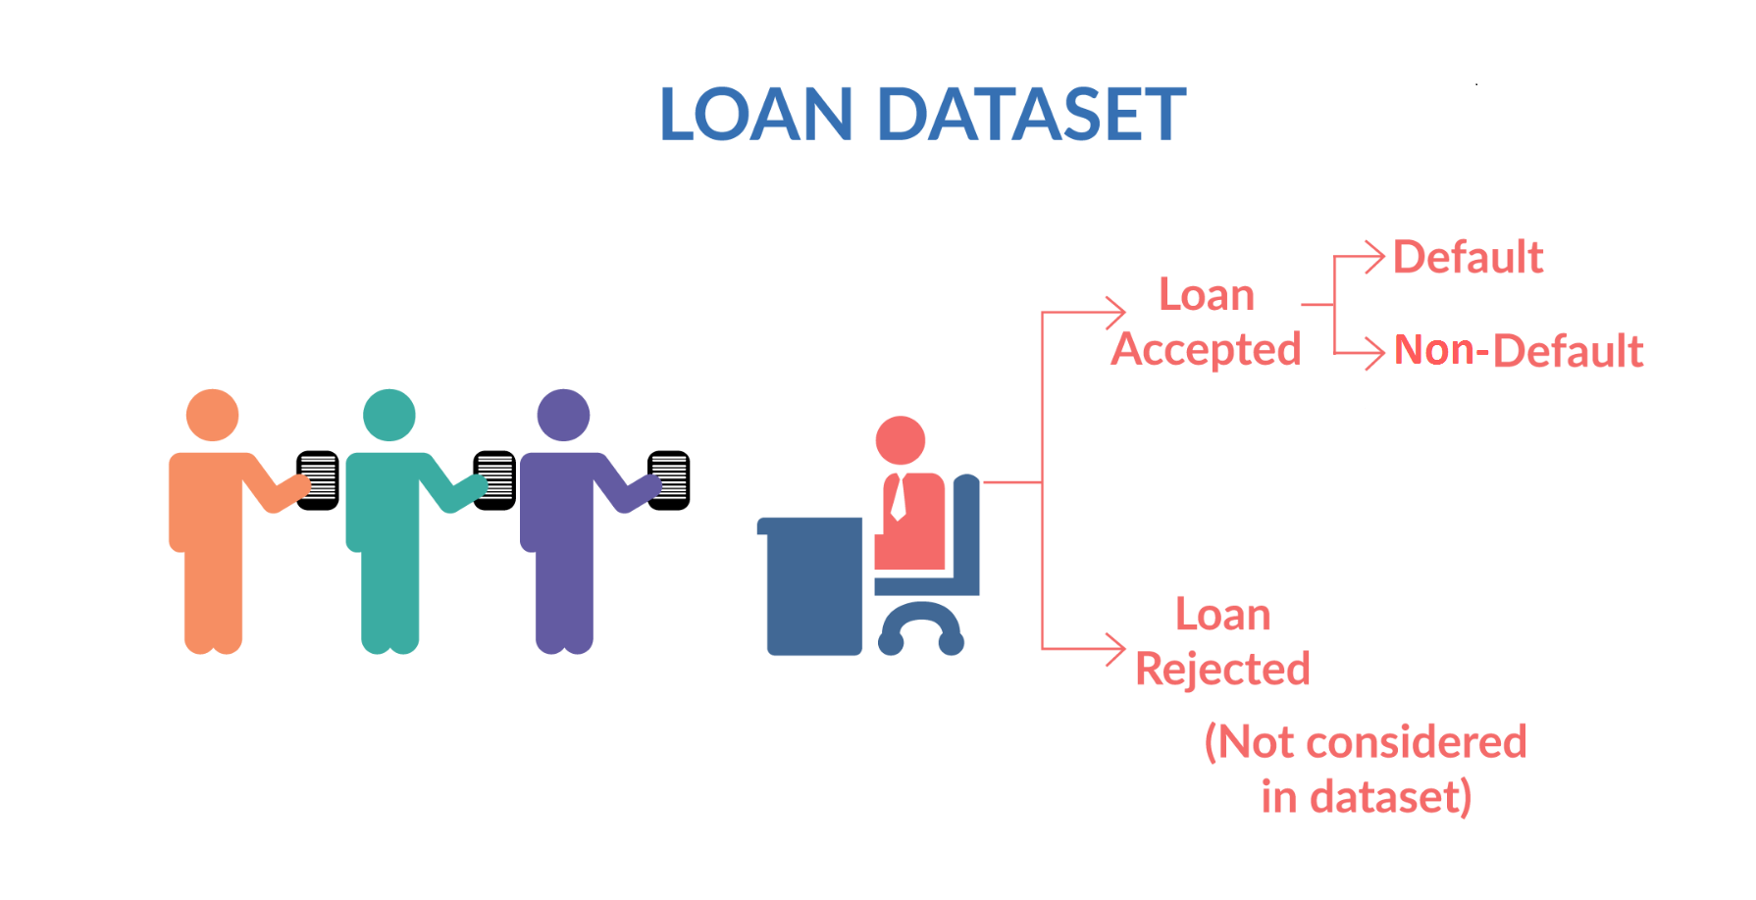
Business Understanding

Slide 6
Approach
Data Understanding
Data
Cleaning
Univariate Analysis
Univariate Segmented Analysis
Conclusion
Bivariate Analysis

Slide 7
Data Understanding & Cleaning
The provided data had a lot of null values. Columns with more than 60% null have been dropped and are also imputed wherever applicable
Few of the columns had malformed data. Those were standardized.
Business driven, data driven and type driven derived columns are created as required.
Checked for duplicate data throughout if any in the dataset. There were no duplicate rows
After understanding and cleanup, proceeded with data analysis

Slide 8
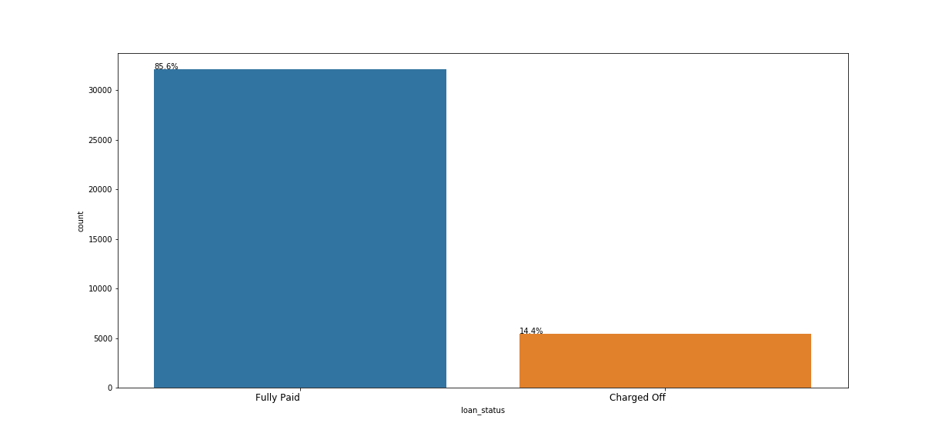
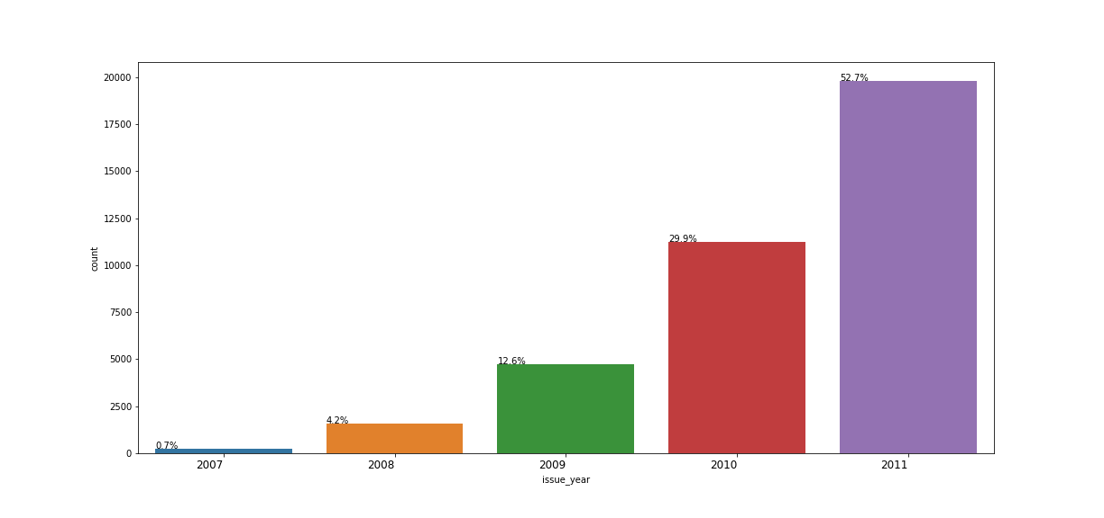
Impact on Loan Status

